Slide 1
Medical Debt 101: Know Your Rights About Medical Bills
Shelly Tsai, Staff Attorney
Bernadette Manigault, Senior Attorney
Jackie Dai, Supervising Attorney
Health Consumer Center

Slide 2
What is Health Consumer Center
Help Line serving LA County residents for help with health insurance questions or access to health care problems
Common issues:
  Eligibility for Medi-Cal, Covered CA
  Accessing specialty care (including private insurance)
  Medical debt
Level of service ranges from information and referral to direct representation in an administrative hearing or in state court

Slide 3
Presentation Overview
1. Am I responsible for the debt?
  Special rules for medical debt collection
2. Can the debt still be collected?
3. Should someone else pay?
  Third party liability
  Dealing with surprise bills
  Medical coding errors
4. Options for eliminating or reducing debt
  Dealing with medical coding errors
5. Debt cannot be eliminated or reduced
6. Other responses to debt collection
  Check your credit report
  Rules regulating debt collectors
  Tools for fighting back

Slide 4

How to Prioritize Medical Bills vs.
Other Types of Bills
1. Am I Responsible for the Debt?
  Check List
    Did you (or patient) receive the medical services or goods listed?
    Are there duplicate charges or charges that should not be included?
    Are you a legally responsible relative (parent/minor child, married spouse/registered domestic partner)?
    Did you sign a financial liability form?

Slide 5
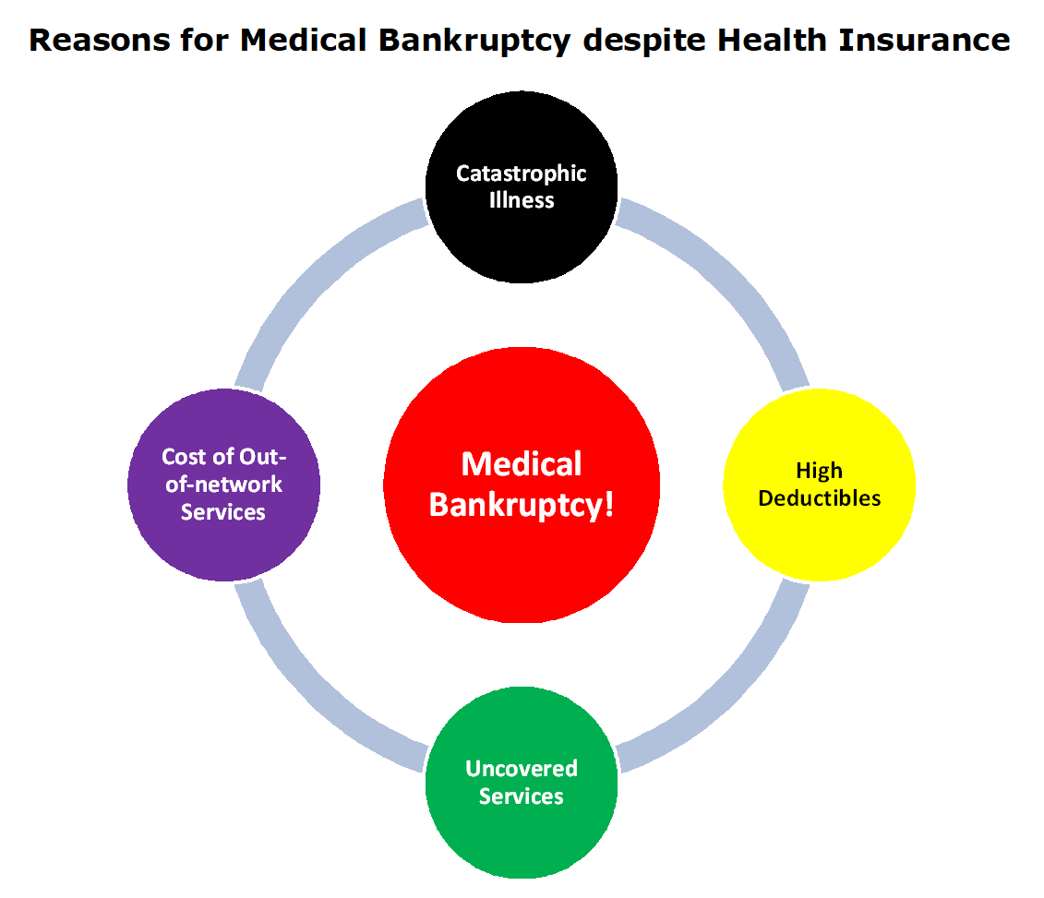
How to Prioritize Medical Bills vs.
Other Types of Bills
Special Rules for Medical Debt Collection
  Soft pause on debt collection
    180 days after initial hospital billing (hospitals must determine charity care/discount eligibility determination for households with income up to 400% FPL)
    120 days from first post-discharge billing statement nonprofit hospitals per IRS rules
    180 days after initial billing from medical providers - Experian, Equifax, Transunion per settlement agreement
    Does not apply if the creditor is not a medical provider (e.g., Care Credit, Lending Club, etc.)

Slide 6
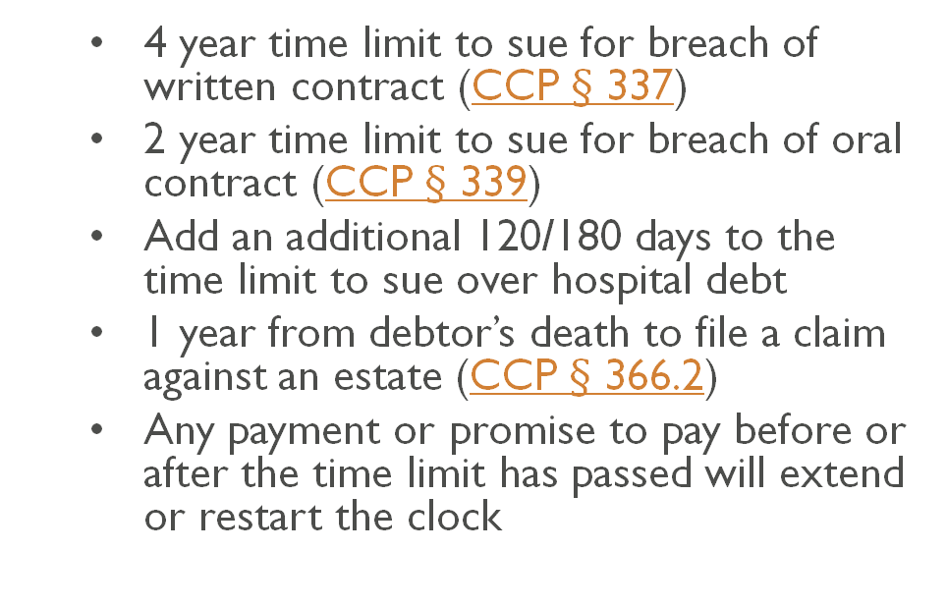
How to Prioritize Medical Bills vs.
Other Types of Bills
2. Can the Debt Still Be Collected?
  Statute of Limitations
    4 year time limit to sue for breach of written contract (CCP $§$ 337)
    2 year time limit to sue for breach of oral contract (CCP $§$ 339)
    Add an additional 120/180 days to the time limit to sue over hospital debt
    1 year from debtor’s death to file a claim against an estate (CCP $§$ 366.2)
    Any payment or promise to pay before or after the time limit has passed will extend or restart the clock

Slide 7
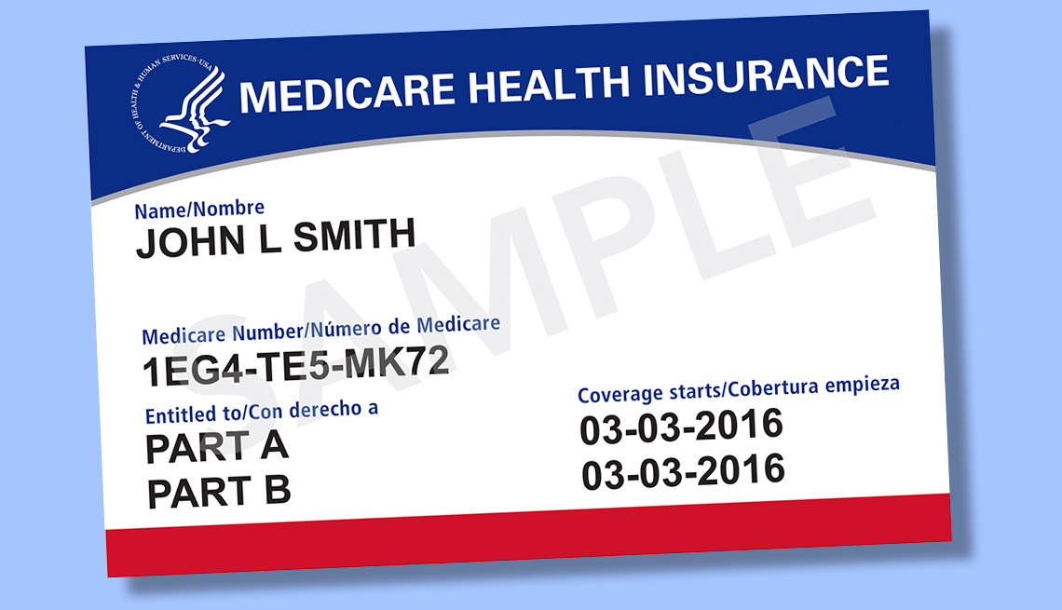
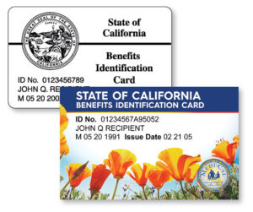
3. Should Someone Else Pay?
  Medi-Cal or Medicare
  Only providers who contract with Medi-Cal/Medicare can bill these programs
  Medi-Cal/Medicare providers cannot seek payment from a beneficiary other than cost-sharing
  Hospitals are required to screen for Medi-Cal eligibility or assist with Medi-Cal applications
  Medi-Cal can cover up to 3 months prior to the month of application
  Patients must provide insurance information on date or service or as soon as possible as approved for Medi-Cal (one-year time limit to bill)

Slide 8

Success Story #1
Jessica, age 71, was sued by a nursing home for her late husband’s debt.
  Health Consumer Center (HCC) helped her respond to the lawsuit.
  Original debt was almost $80,000. With our assistance she paid less than 5% of the amount asked in the lawsuit. Medi-Cal paid the rest.

Slide 9

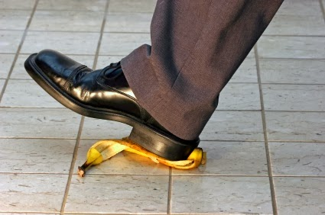

Third Party Liability
  Other insurance coverage may be responsible
    Automobile insurance
    Property insurance
    Worker’s compensation
    Other health coverage (dual insurance)
    Other tortfeasor

Slide 10
Case Study: Surprise Billing
Alex went to a hospital for knee surgery. Before the surgery, he confirmed with the health plan, the hospital, and the surgeon to make sure the surgery is approved by the health plan. He also confirmed that the hospital and the surgeon are in-network. A month after the surgery, he receives a bill from an anesthesiologist who is out-of-network.
What happened?
What can he do?

Slide 11

Dealing with Surprise Bills
  “Surprise” bills
  AB 72, a state law against surprise medical bills from Out-of-Network providers when you go to in-network facilities (excludes self-funded plans)
  Federal No Surprise Act, effective 1/1/2022 includes self-funded plans
  File a complaint with the health plan and attach a copy of the bill. Insurance plan should tell the provider to stop billing you. If you disagree with your health plan’s response, you can call the Health Consumer Center

Slide 12

Alex’s Options
Step 1: File a complaint with his health plan. The plan has 30 days to respond. Self-funded plans may have a different time frame.
Step 2: If this is a self-insured plan, follow the plan’s appeals process.
If this is not a self-funded plan and the plan fails to respond within 30 days, or if Alex disagrees with the plan’s decision, he may file a complaint with the Department of Managed Health Care (DMHC).

Slide 13
4. Options for Eliminating or Reducing Debt
Tell the hospital or the emergency physician billing office that you want to apply for their “Financial Assistance Program” or tell them you can’t afford to pay
Look up the hospital financial assistance program
Ambulance companies are not required to offer financial assistance, but many do offer discount if asked
Do not ignore the bill. It will affect your credit score and may increase the amount owed
  Lower credit scores can impact your ability to get housing, loans, and may increase future borrowing costs

Slide 14

Success Story #2
John and Eva were sued by a debt collector for nearly $15,000 in hospital bills. John had employer group insurance on the date of service, but he could not afford the high deductible. Wife Eva was uninsured on the date of service.
  HCC encouraged the couple to apply for hospital financial assistance. HCC sent them a copy of the application forms and helped them respond to the lawsuit.
  The hospital approved the couple for partial charity care. The hospital debt is reduced to 3% the amount asked in the lawsuit.

Slide 15

Dealing with Medical Coding Errors
Create a paper trail of dispute with provider
  Check your health plan’s Explanation of Benefits
  Check for duplicate charges on statement
  Request a written explanation from the medical provider and take the protest to the top person in charge of billing
  If you believe the bill is wrong, explain in writing why you think it is wrong, and ask them to fix it
  Keep calling customer service line or billing department and follow up in writing; escalate up the chain of command
  File a complaint with your health plan

Slide 16
5. Debt Cannot Be Eliminated or Reduced
  Are you judgment proof?
    Income and property private creditors can’t seize
  Is this an old debt?
    Time limit for filing a lawsuit (“time-barred”)
    Most of the negative items will be removed from credit report automatically after seven years from date of first missed payment
  Can you afford to pay?
    Remember you may end up extending the time limit to file a lawsuit.
    Consider contacting Department of Consumer & Business Affairs (DCBA) Mediation Clinic or Loyola Center for Conflict Resolution
  Do you have significant consumer debts?
    Contact our bankruptcy clinic

Slide 17
6. Other Responses to Debt Collection
Write a letter to the biller requesting itemized bill with insurance/claims information
Request the debt collector validate the debt
Timely respond to a lawsuit filed against you
Consult with a private consumer law attorney if:
  a debt collector is harassing you, disclosing your medical condition on the credit report
  you have a tort claim against the creditor (e.g., medical malpractice, fraud, duress, undue influence)
  You have a breach of contract claim against an insurance carrier.

Slide 18
Check Your Credit Report
Get free credit report through AnnualCreditReport.com
  Free weekly report until April 2022
Check if a medical debt has been reported
  Learn about credit report basics by going to the Consumer Financial Protection Bureau (CFPB) website
  Dispute an error on credit report
  Submit a complaint with the CFPB if a credit reporting agency failed to respond to or investigate your dispute
  File a complaint with Health & Human Services Office of Civil Rights for unlawful disclosure of medical condition on a credit report

Slide 19
Rules Regulating Debt Collectors
  Subject to state and federal fair debt collection laws
    A debt collector cannot: (1) Contact you before 8am or after 9pm; (2) make continuous or repeated calls over a short time period to harass, abuse, or annoy you; (3) contact you at work without permission; (4) contact your employer, friends, or other people in your life; (5) threaten you or use bad/offensive language; (6) say your immigration status will be taken away; (7) pretend they are an attorney; (8) say you will go to prison or be arrested if you don’t pay
  Debt collectors cannot threaten to sue over a time-barred debt
  New social media rules effective 11/30/2021 - debt collectors can text, email, contact you by social media with your permission; opt out anytime
  HIPAA privacy rule requires a collection agency to reasonably limit the amount of information disclosed (can’t disclose medical condition)

Slide 20

Tools for Fighting Back
Report unscrupulous business practices of Medi-Cal dental providers
File a grievance/complaint with your health plan if you think a bill should have been covered; escalate complaint to the Department of Managed Health Care (DMHC) unless it is a self-funded plan
File a complaint with California Department of Financial Protection and Innovation (DFPI) against a debt collector who is engaging in unfair debt collection practices, or if your medical/dental provider arranged a credit or loan extended by a third party without first providing you with a written or electronic one-page notice in 14 point type listing your rights as a consumer applying for financing as required by BPC § 654.3(d).

Slide 21

More Tools for Fighting Back
Demand in writing a refund from the medical provider for services/products not received. Caveat: This would likely disrupt treatment. The medical provider has 15 business days to refund to the lender (bank, credit card) any payment received through credit/loan extended by the third party; at the same time, file a written dispute with the lender to stop interest and late fees from accruing pending the investigation by the lender
Contact the media – Submit your medical bill to Kaiser Health News’s Bill of the Month

Slide 22
Contact Information
Call NLSLA
General Help Line: 1 (800) 433-6251
Health Help Line: 1 (800) 896-3202
You may leave a message Monday - Friday between 9am - 5pm.
Someone will return your call as soon as possible.
Apply for Help Online
www.nlsla.org
You may submit a request for help at any time.
Someone will give you a call during business hours, Monday - Friday between 9am - 5pm.

Slide 23
Contact Our Self Help Legal Access Centers
Chatsworth: 818-485-0571, CSHpublic@nlsla.org
Pomona: 818-485-0572, PSHpublic@nlsla.org
Antelope Valley: 818-485-0573, AVSHpublic@nlsla.org
Van Nuys: 818-485-0574, VNSHpublic@nlsla.org
Pasadena: PasadenaUDpublic@nlsla.org (no phone available)
Help with Stanley Mosk evictions: Shriver Help line at 818-485-0576 or email ShriverSHPublic@nlsla.org

